Slide 1
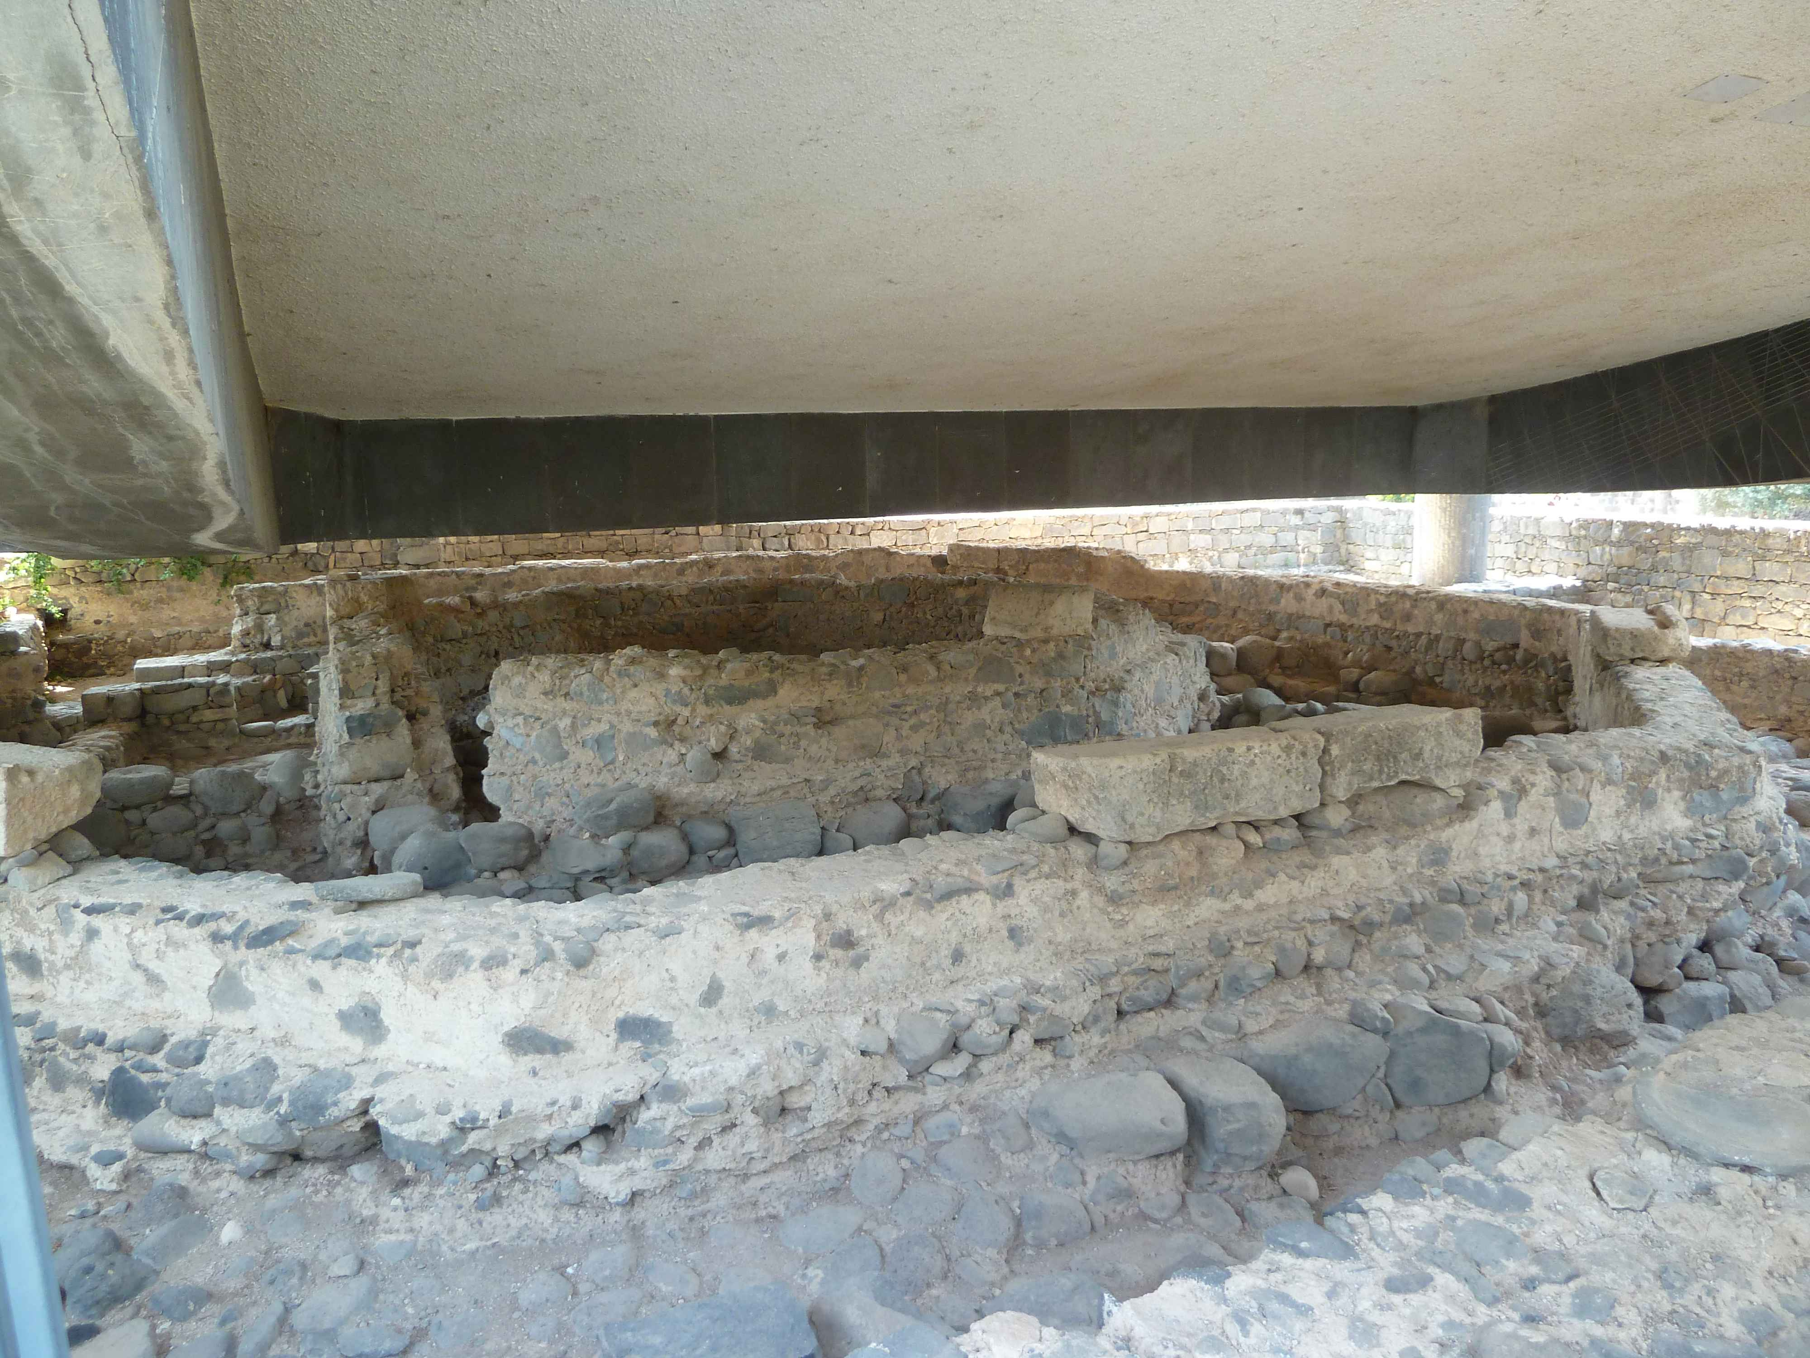
Remains of Peter’s house in Capernaum
[Traditional location dating to fourth century]
John 6.22-40

Slide 2
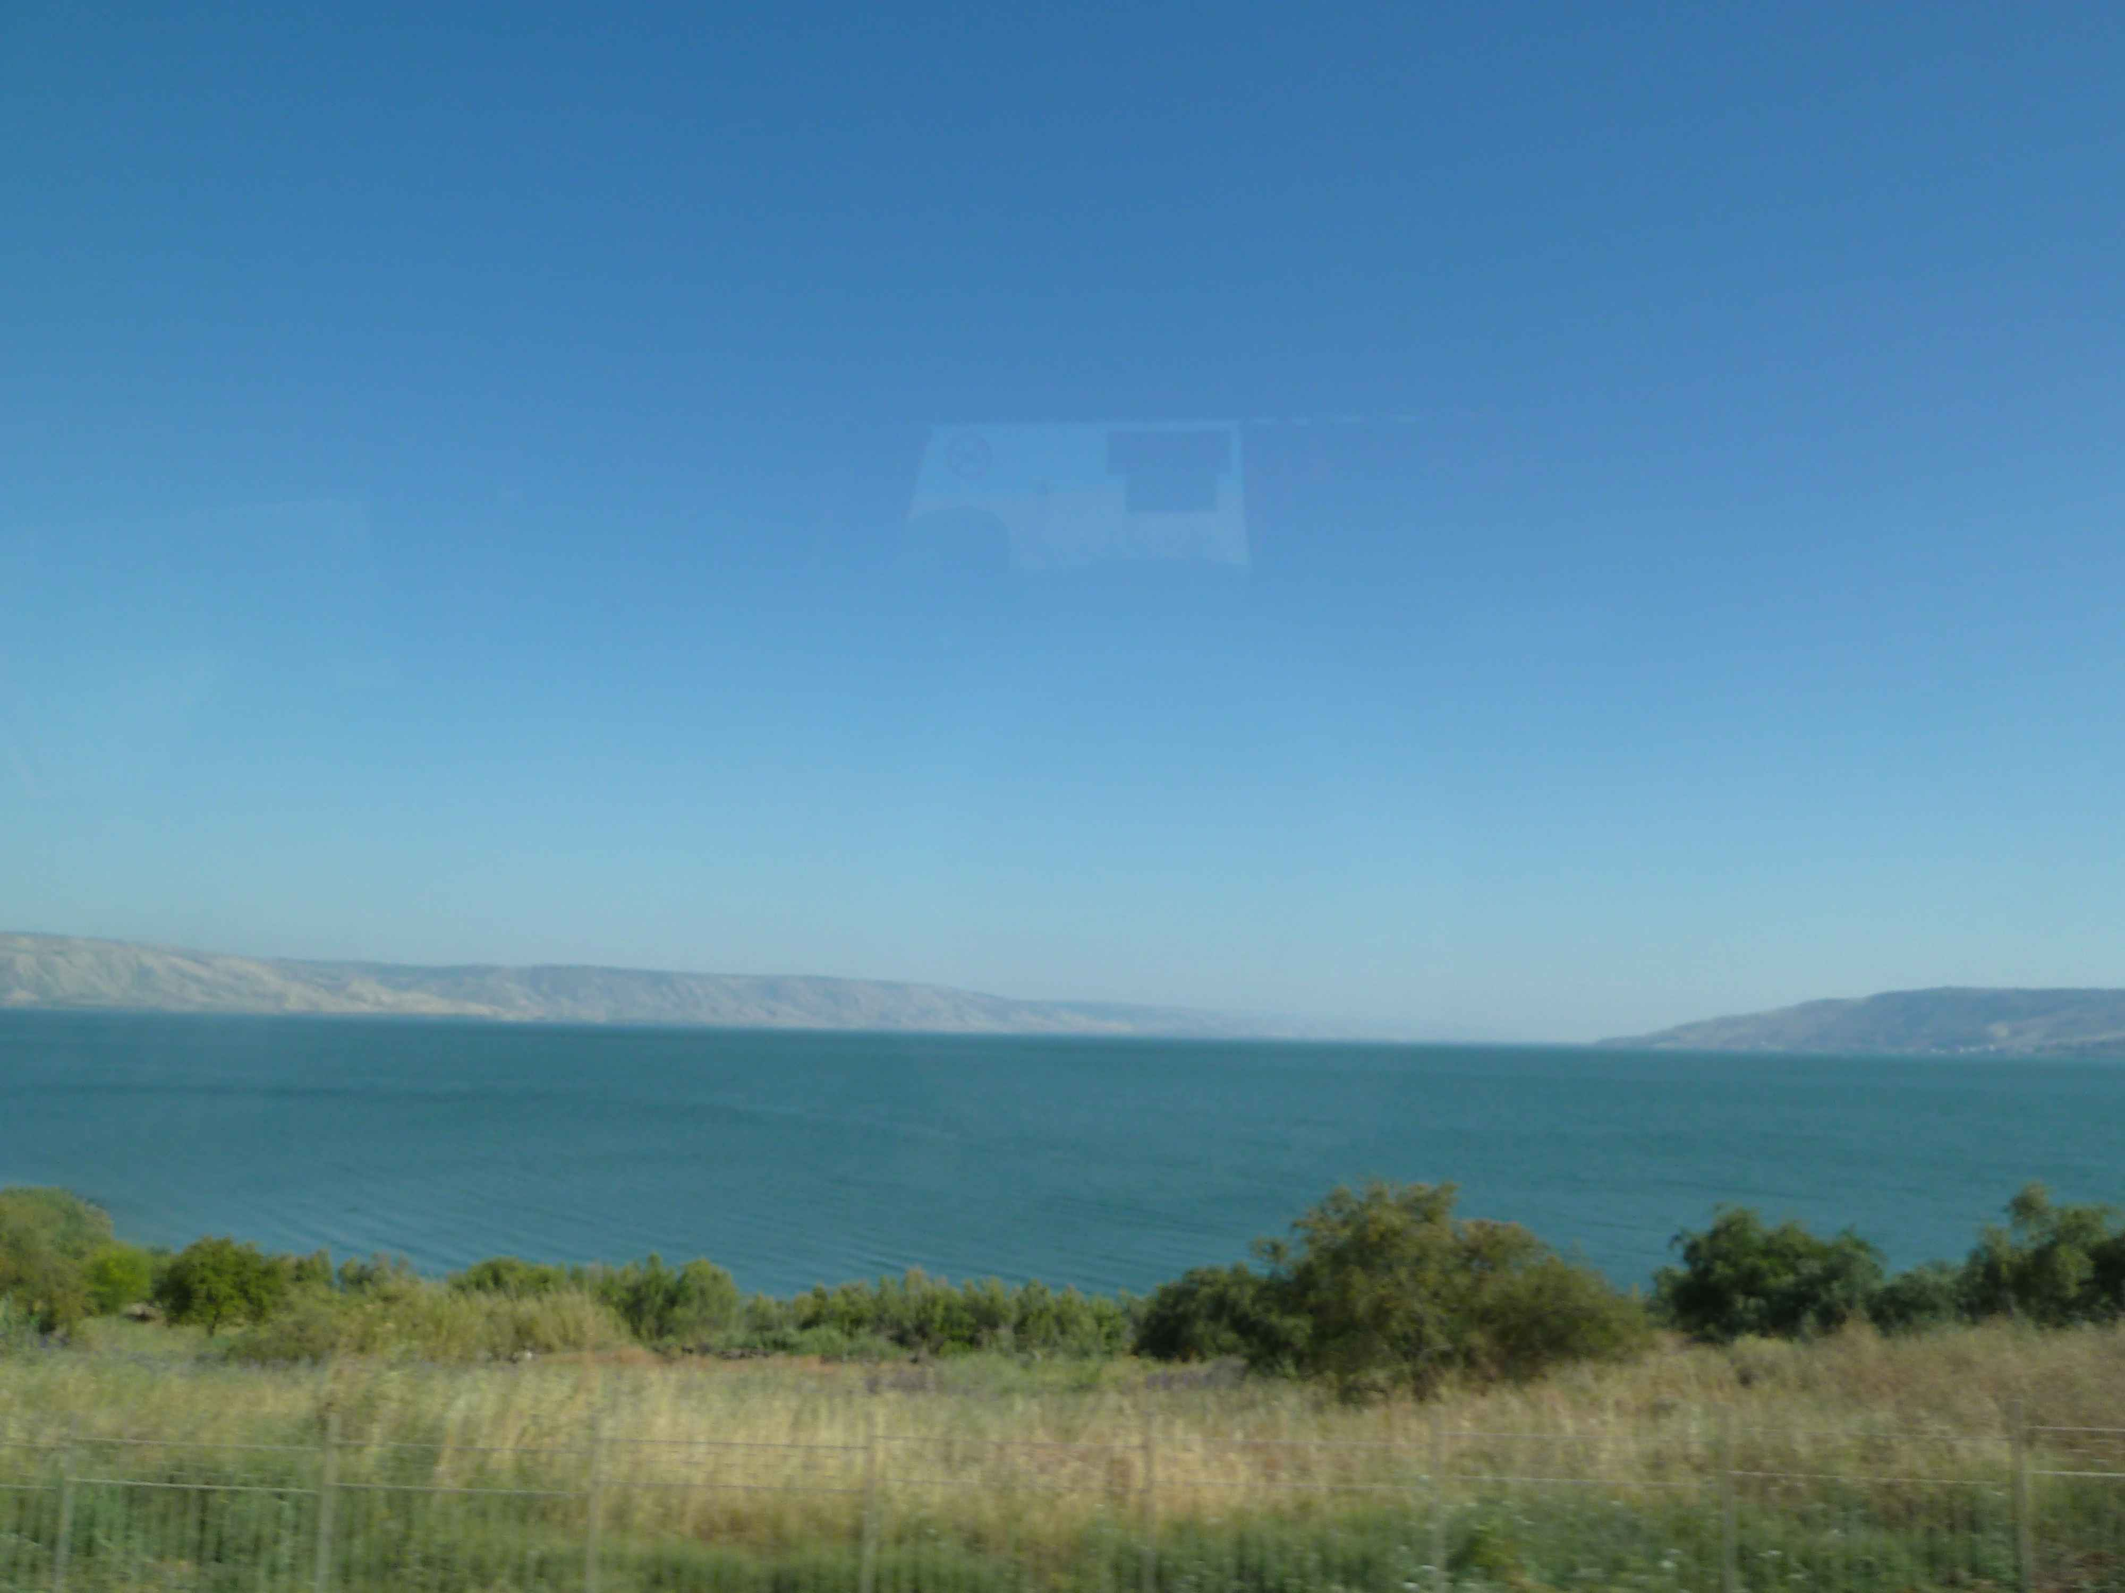
John 6.22-24 NET: The next day the crowd that remained on the other side of the lake realized that only one small boat had been there, and that Jesus had not boarded it with his disciples, but that his disciples had gone away alone. ²³But some boats from Tiberias came to shore near the place where they had eaten the bread after the Lord had given thanks. ²⁴So when the crowd realized that neither Jesus nor his disciples were there, they got into the boats and came to Capernaum looking for Jesus.

Slide 3
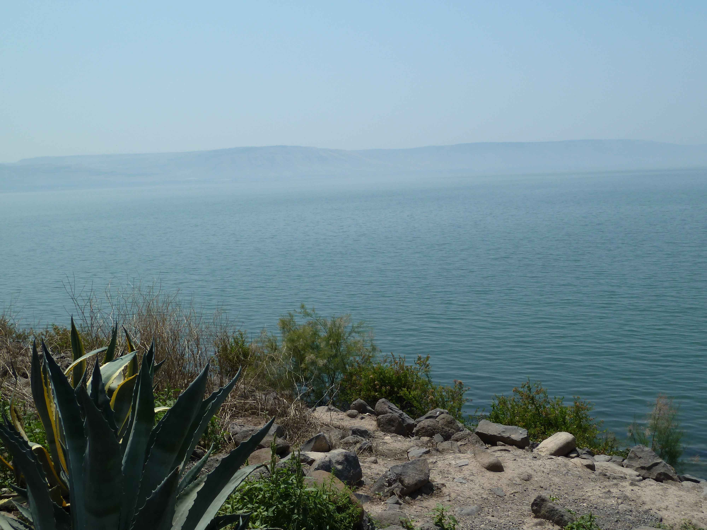
John 6.25-27 NET: When they found him on the other side of the lake, they said to him, “Rabbi, when did you get here?” ²⁶Jesus replied, “I tell you the solemn truth, you are looking for me not because you saw miraculous signs, but because you ate all the loaves of bread you wanted. ²⁷Do not work for the food that disappears, but for the food that remains to eternal life– the food which the Son of Man will give to you. For God the Father has put his seal of approval on him.”

Slide 4
John 6.26: Jesus replied, “I tell you the solemn truth, you are looking for me not because you saw miraculous signs, but because you ate all the loaves of bread you wanted.”

Slide 5
John 6.27: “Do not work for the food that disappears, but for the food that remains to eternal life– the food which the Son of Man will give to you. For God the Father has put his seal of approval on him.”

Slide 6
John 6.27: “Do not work for the food that disappears, but for the food that remains to eternal life– the food which the Son of Man will give to you. For God the Father has put his seal of approval on him.”

Slide 7
John 6.28-29: So then they said to him, “What must we do to accomplish the deeds God requires?”
²⁹Jesus replied, “This is the deed God requires– to believe in the one whom he sent.”

Slide 8
John 6.30-31: So they said to him, “Then what miraculous sign will you perform, so that we may see it and believe you? What will you do?
³¹Our ancestors ate the manna in the wilderness, just as it is written, ‘He gave them bread from heaven to eat.’”

Slide 9
John 6.32-33: Then Jesus told them, “I tell you the solemn truth, it is not Moses who has given you the bread from heaven, but my Father is giving you the true bread from heaven.
³³For the bread of God is the one who comes down from heaven and gives life to the world.”

Slide 10
John 6.34-36: So they said to him, “Sir, give us this bread all the time!” ³⁵Jesus said to them, “I am the bread of life. The one who comes to me will never go hungry, and the one who believes in me will never be thirsty. ³⁶But I told you that you have seen me and still do not believe.

Slide 11
John 6.35: Jesus said to them, “I am the bread of life. The one who comes to me will never go hungry, and the one who believes in me will never be thirsty.
οὐ μὴ = certainly not

Slide 12
John 6.35: Jesus said to them, “I am the bread of life. The one who comes to me will never go hungry, and the one who believes in me will never be thirsty.
Coming = believing = positive response in faith
Greek present tense participles indicate continuousness of coming and believing.

Slide 13
John 6.34-36: So they said to him, “Sir, give us this bread all the time!” ³⁵Jesus said to them, “I am the bread of life. The one who comes to me will never go hungry, and the one who believes in me will never be thirsty. ³⁶But I told you that you have seen me and still do not believe.

Slide 14
John 6.37-40: Everyone whom the Father gives me will come to me, and the one who comes to me I will never send away. ³⁸For I have come down from heaven not to do my own will but the will of the one who sent me. ³⁹Now this is the will of the one who sent me– that I should not lose one person of every one he has given me, but raise them all up at the last day. ⁴⁰For this is the will of my Father– for everyone who looks on the Son and believes in him to have eternal life, and I will raise him up at the last day.”

Slide 15
John 6.39-40: Now this is the will of the one who sent me– that I should not lose one person of every one he has given me, but raise them all up at the last day. ⁴⁰For this is the will of my Father– for everyone who looks on the Son and believes in him to have eternal life, and I will raise him up at the last day.”
If God gives you to Jesus, you will believe.
If you believe, you have eternal life and can’t lose it.
If you believe, you will be raised to life at the end.

